Slide 1
ACS Annual Income Project
Trent Steller

Slide 2
Project Overview
American Community Survey, 5-year data (2018-2022)
Data from the US Census Bureau
Data accessed through tidycensus R package

Slide 3
Key Stakeholders
State and local policymakers
See what demographics can be used to identify vulnerable households
Labor economists
Further validate (or refute) relationships among certain variables and income
Financial services companies
Understand income demographics and tailor their services accordingly

Slide 4
Project Goal
How well can annual household income be predicted based on certain demographic variables?

Slide 5
Dataset Overview
Source
2018–2022 5-year ACS data accessed via the tidycensus package
Unit of analysis
Annual household income
Sample
Random 0.10% sample of households from the full ACS file
Restrictions
Only households with positive reported income and complete information on all predictors used in the models

Slide 6
Variables Analyzed
Demographic
Age, race, sex, marital status
Education level
Employment status
Number of people per household
Housing structure
Home ownership, number of vehicles

Slide 7
Intended Takeaways
Explore the dataset
Find the best model
Why is that model the best?
Apply the model to testing data
Derive key, actionable insights

Slide 8
Data Restrictions
High volume of data – used 0.10% sample of all data
70% train/validate, 30% test
80% of train/validate data into training, 20% into validation

Slide 9
EDA & Cleaning
Remove observations with missing or invalid income
Remove observations without complete information on all predictors
Use logarithm of income data to account for income data being highly right-skewed
Convert data back into dollar units when testing
Derive introductory analysis – what factors should we be searching for?

Slide 10
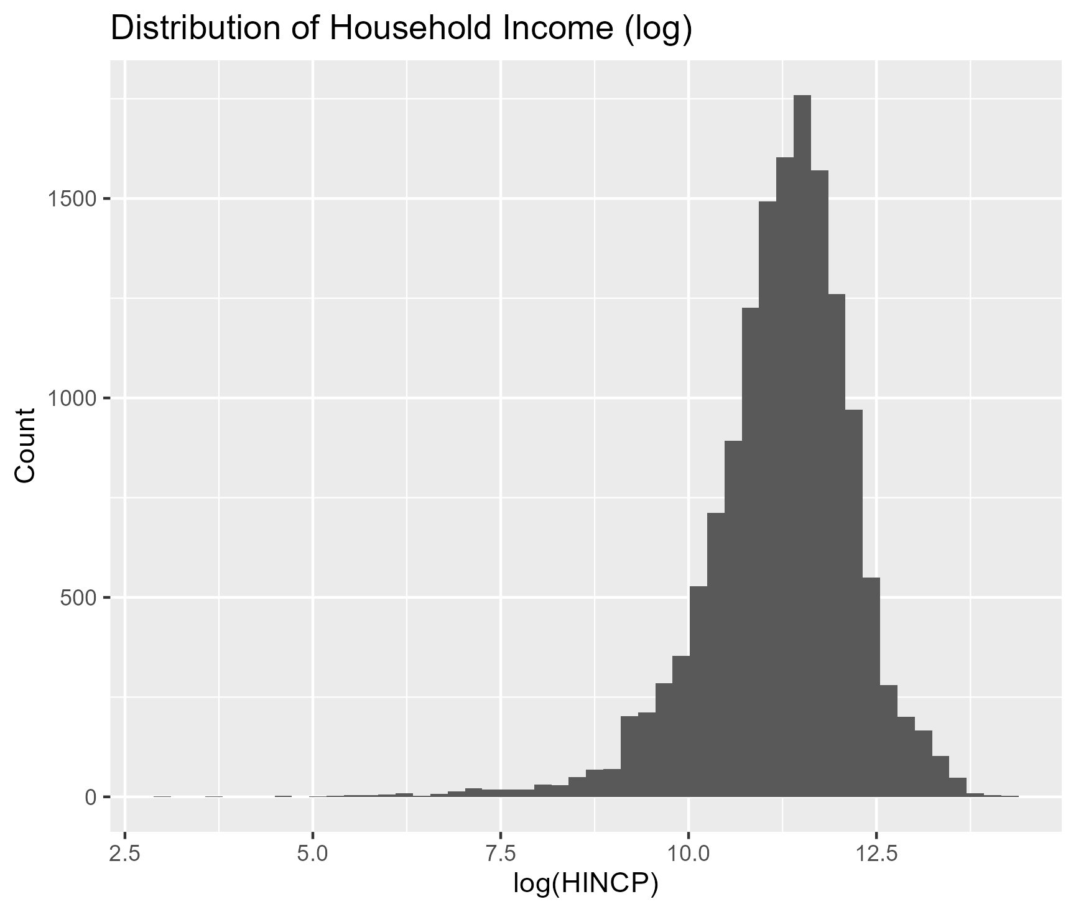
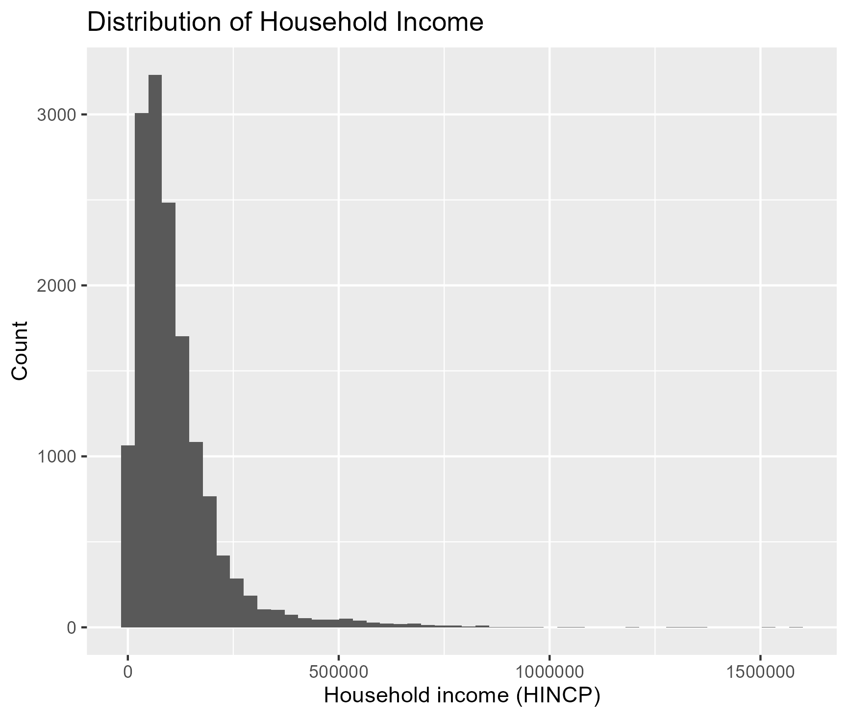
EDA – Importance of log-scale

Slide 11
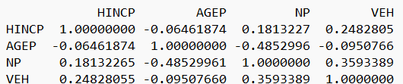
EDA – Correlation Matrix
Rough sense of direction between linear relationships of variable and income
Income vs. age: -0.06, no linear relationship

Slide 12
EDA – Correlation Matrix
Income vs. age: -0.065
Income vs. number of people in household: 0.181
Income vs. number of vehicles: 0.248
Number of people in household vs. number of vehicles: 0.359
Age of people in household vs. number of people in household: -0.485

Slide 13
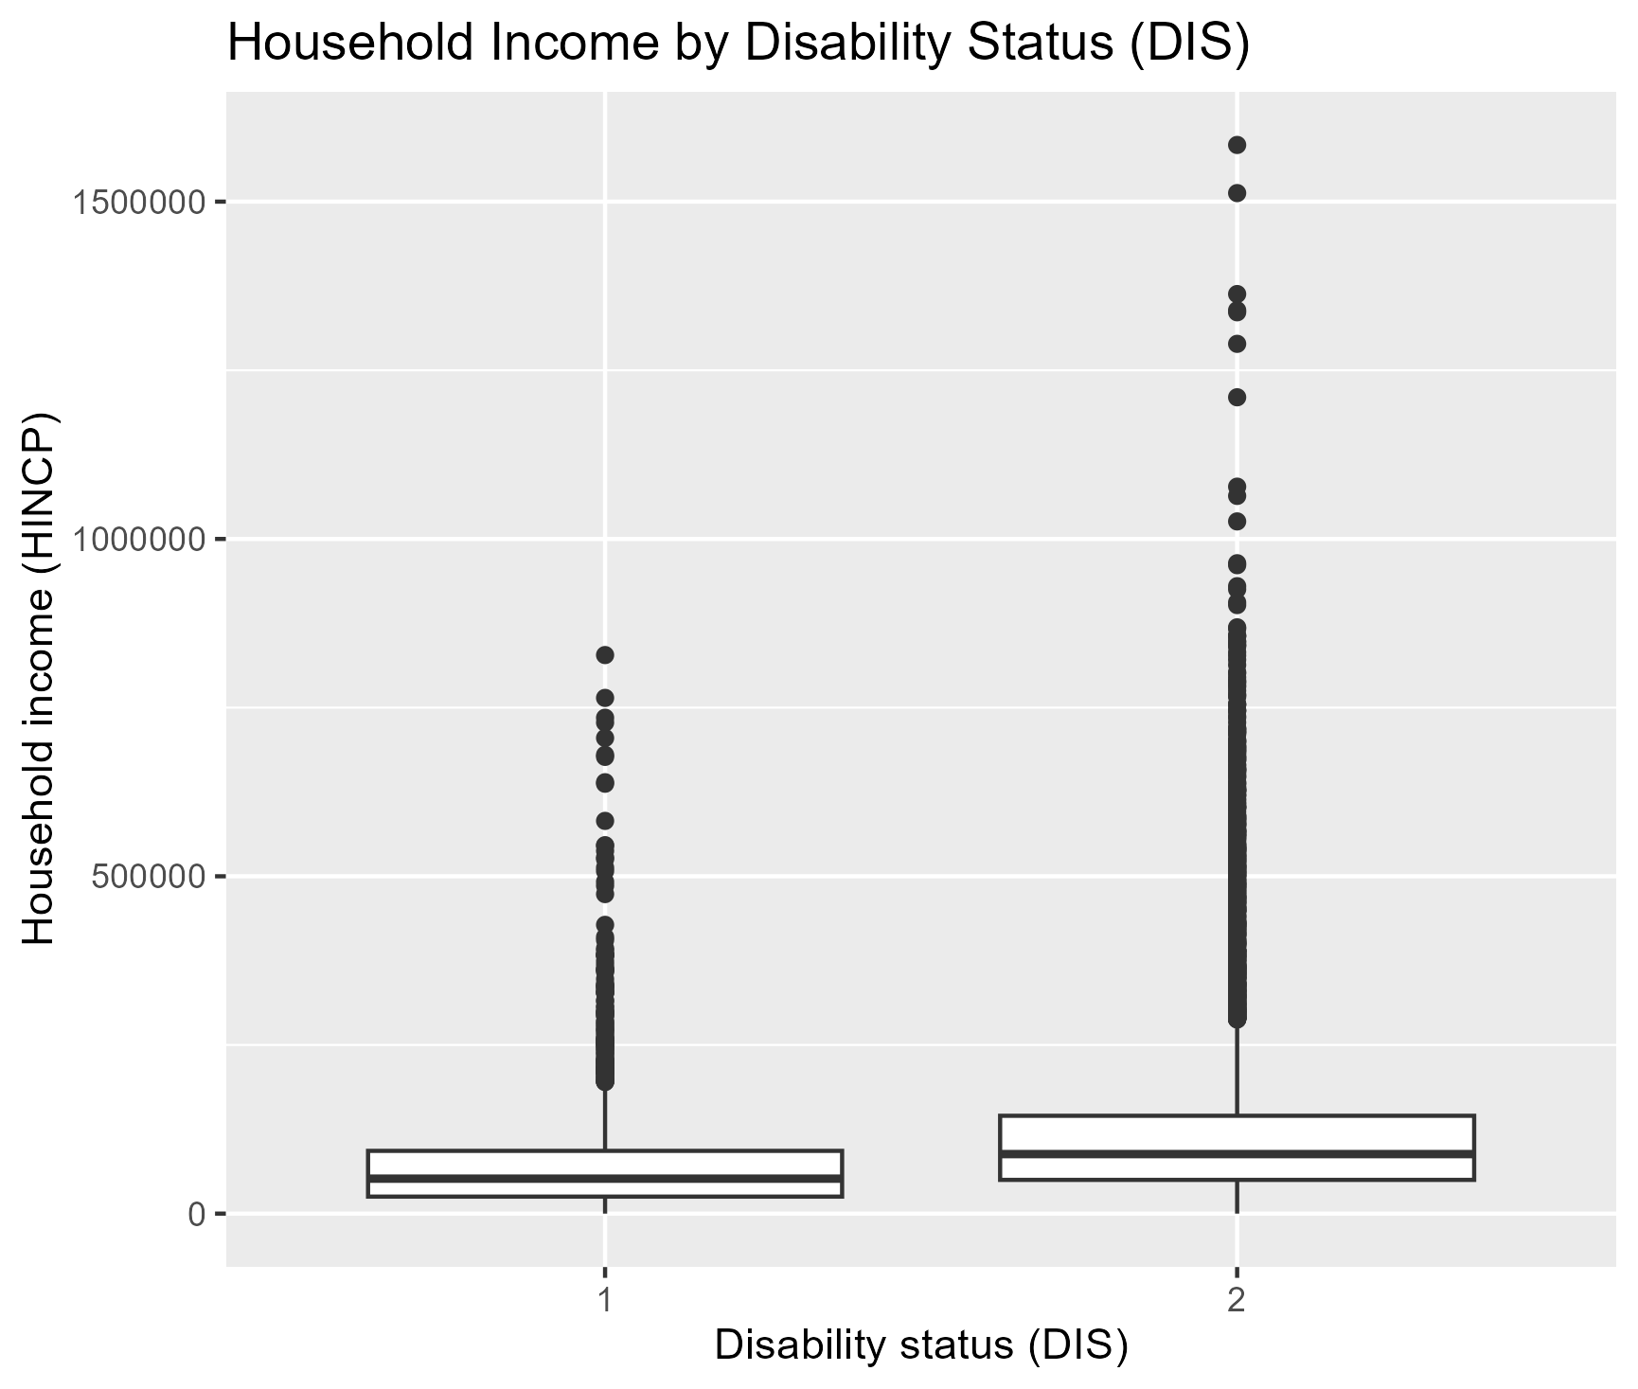
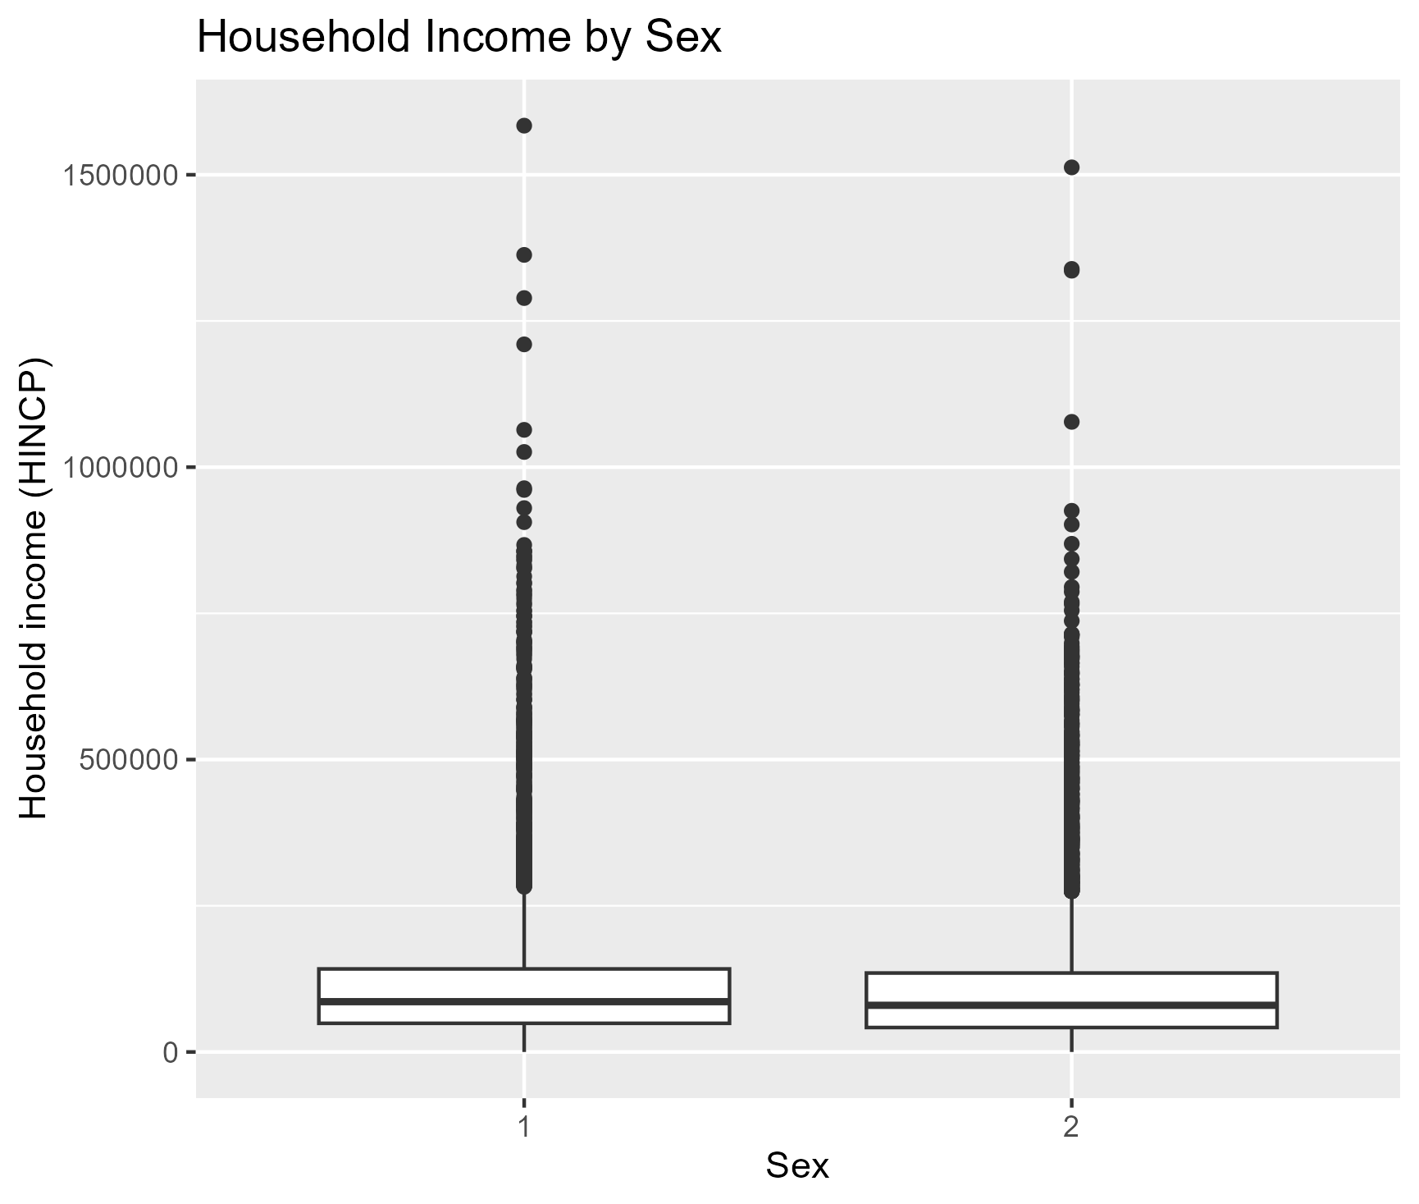
EDA – Categorical Analysis

Slide 14
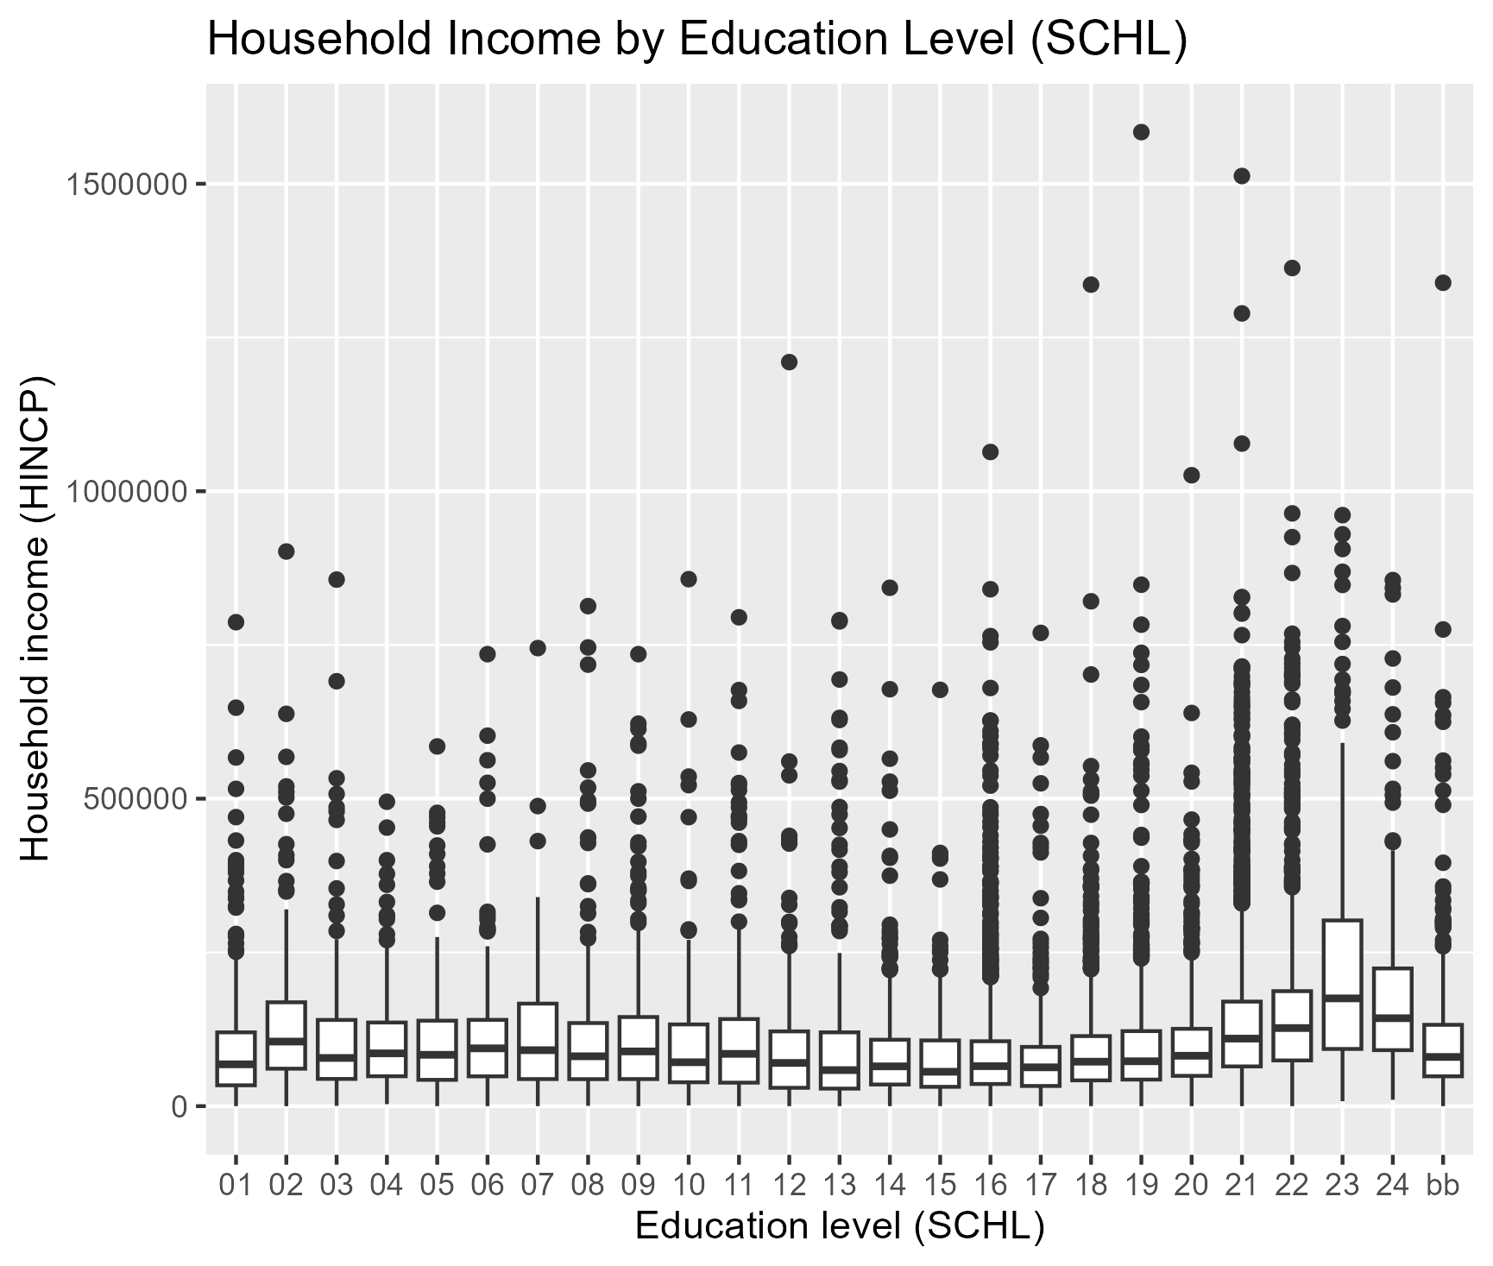
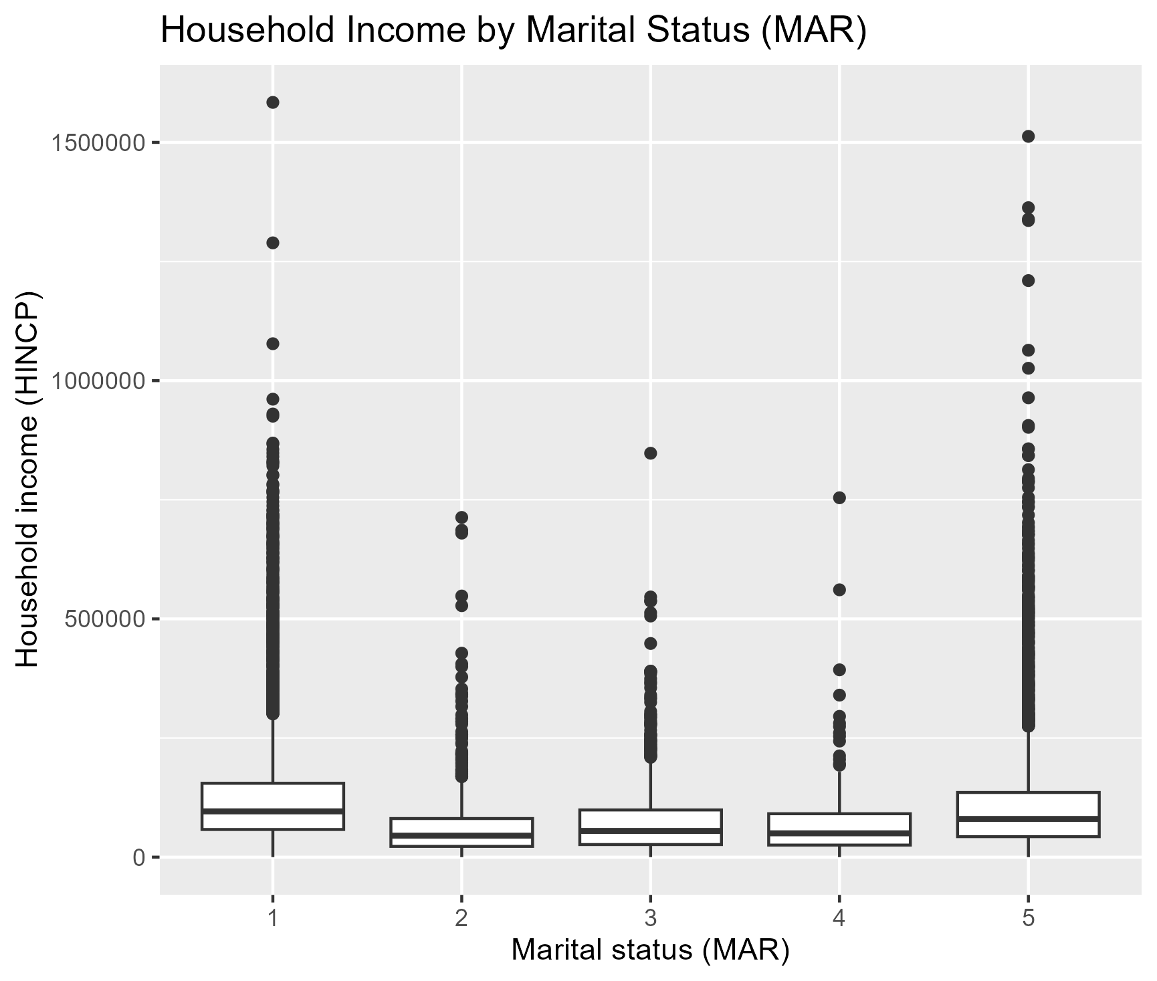
EDA – Categorical Analysis

Slide 15
What does this tell us?
Must manually encode in categories (proper x-axis labels)
Beneficial to split final analysis into income groups

Slide 16
Models Used
Random forest
Provides benchmark on how income can be predicted with certain features
Tree-based model, splits into smaller groups
Linear regression
Basic and full
Provides another benchmark to determine how linearity compares to a tree-based model
Lasso regression
Similar to the linear model, but will shrink weaker variables
Tests whether a simpler and regularized version of linearity generalizes better
XGBoost
More aggressive tree-based model, but also most sensitive
Ran at the end to ensure the other models were stable

Slide 17
Random Forest
Does not try to aptly fit data, but rather tries to keep the most important coefficients
Fewer “active” variables – are there any that may need to be eliminated?
Strong predictive performance, no linearity

Slide 18
Linear Regression
Assumes linearity
Easy to see how each variable is associated with income and holds others constant
Serves as a baseline and interpretability benchmark

Slide 19
Lasso Regression
Does not try to aptly fit data, but rather tries to keep the most important coefficients
Fewer “active” variables – are there any that may need to be eliminated?

Slide 20
XGBoost
More aggressive tree-based model
Depends heavily on data validation and encoding being effective on other models
Each new tree is designed to fix errors in the previous tree

Slide 21
Model Evaluation
model | rmse_log | mae_log
random_forest | 0.850182 | 0.592891767
full_linear_model | 0.852805 | 0.607596501
lasso | 0.853791 | 0.607771908
basic_linear_model | 0.866369 | 0.616980571
xgboost | 0.893397 | 0.63684682

Slide 22
Data Testing
Build final training set by combining test and validation set
Fit metrics onto test set
Then, convert log income back to regular income scale

Slide 23
Testing Results
model | rmse_log | mae_log | rmse_income | mae_income
random_forest | 0.78626 | 0.561747 | 95706.95 | 53570.52

Slide 24
Visualizing Data
Label categorical variables
Use income bands
Low income (<$40k)
Medium income ($40k-$100k)
High income (>$100k)

Slide 25
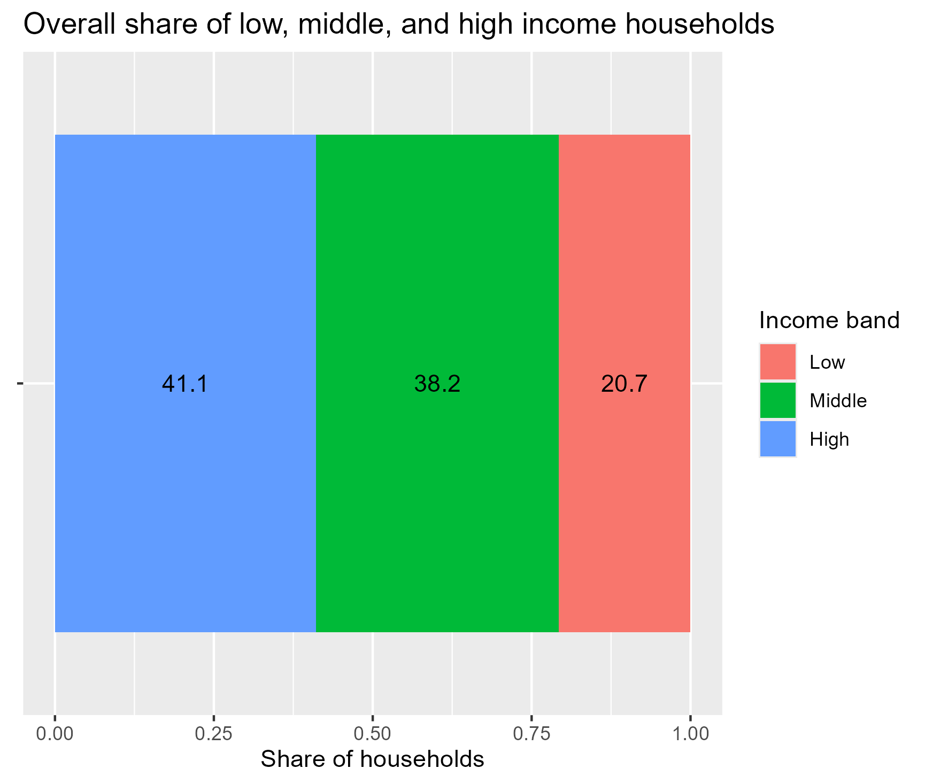
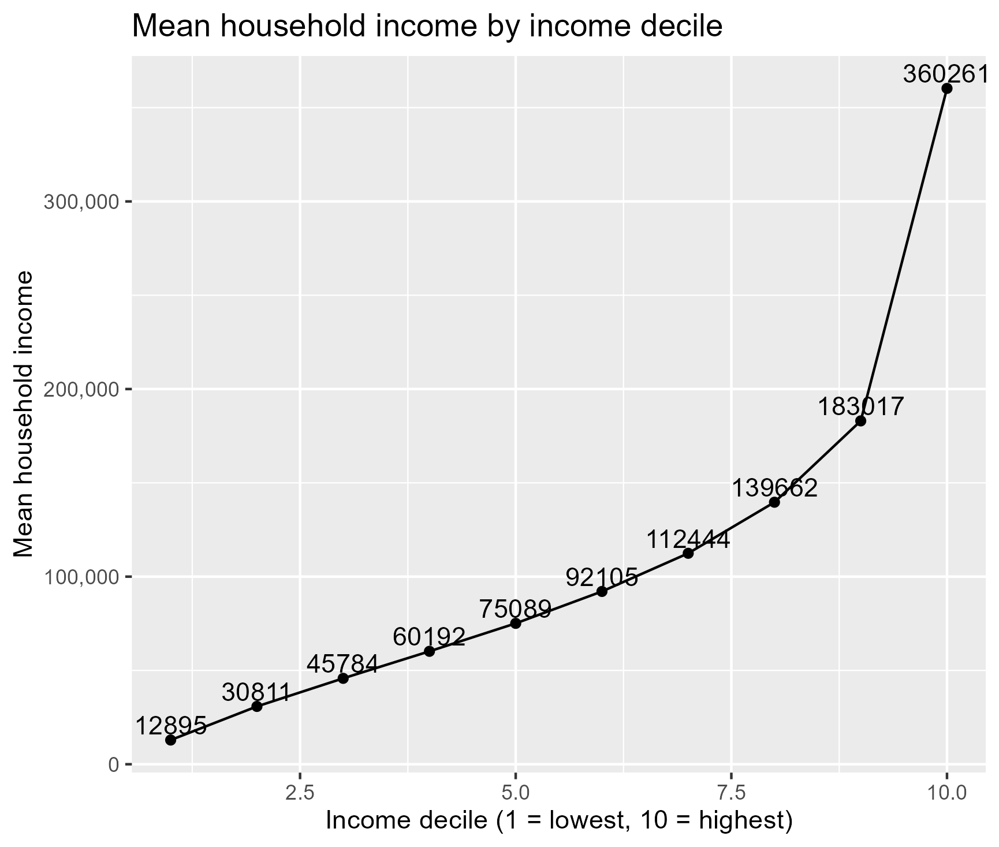
Visualizations – Income Bands

Slide 26
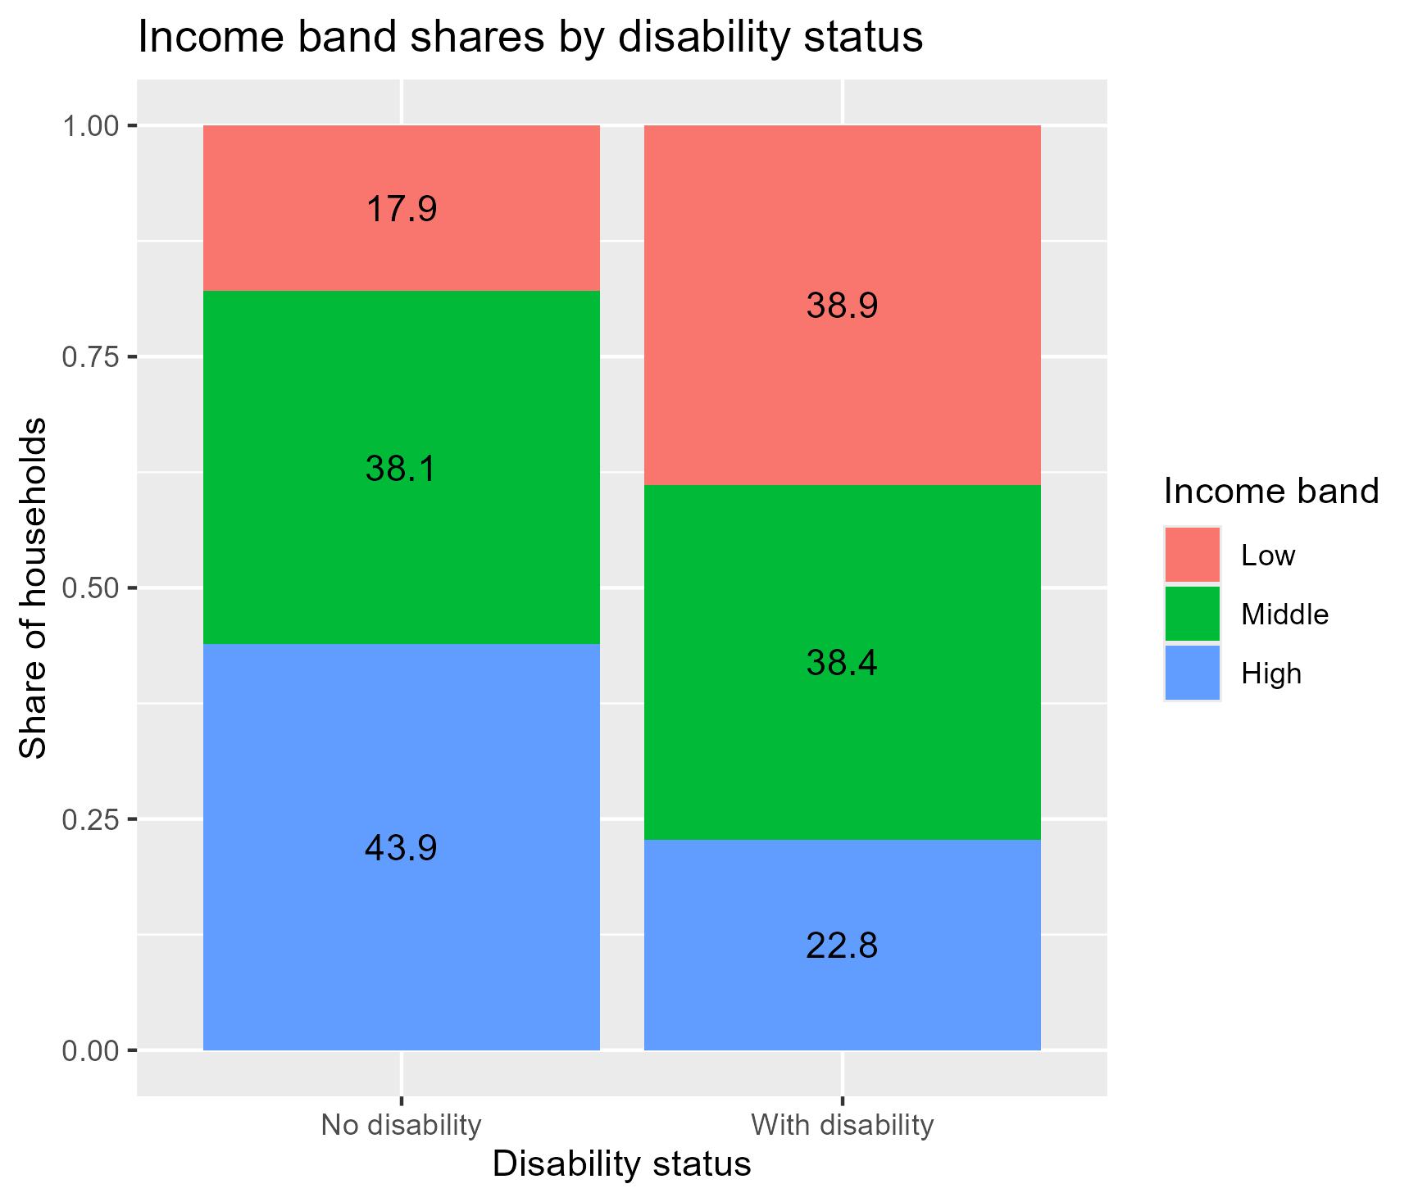
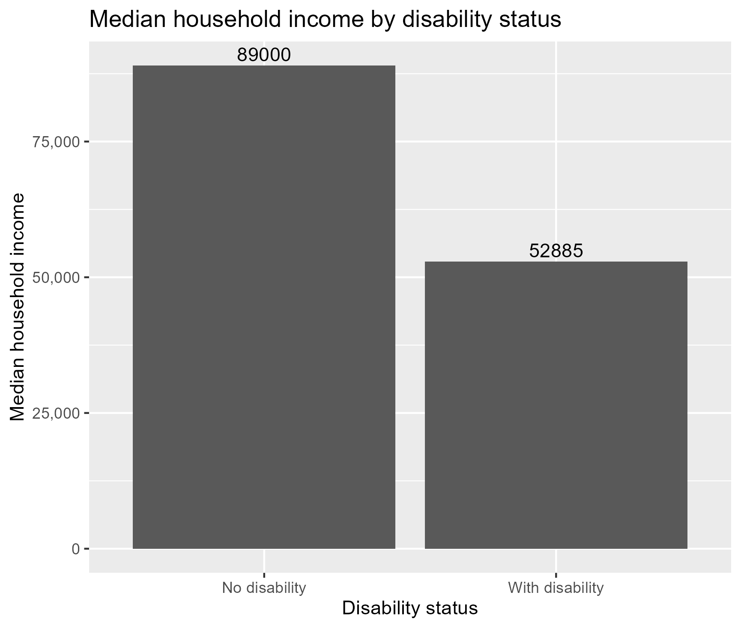
Visualizations – Disability

Slide 27
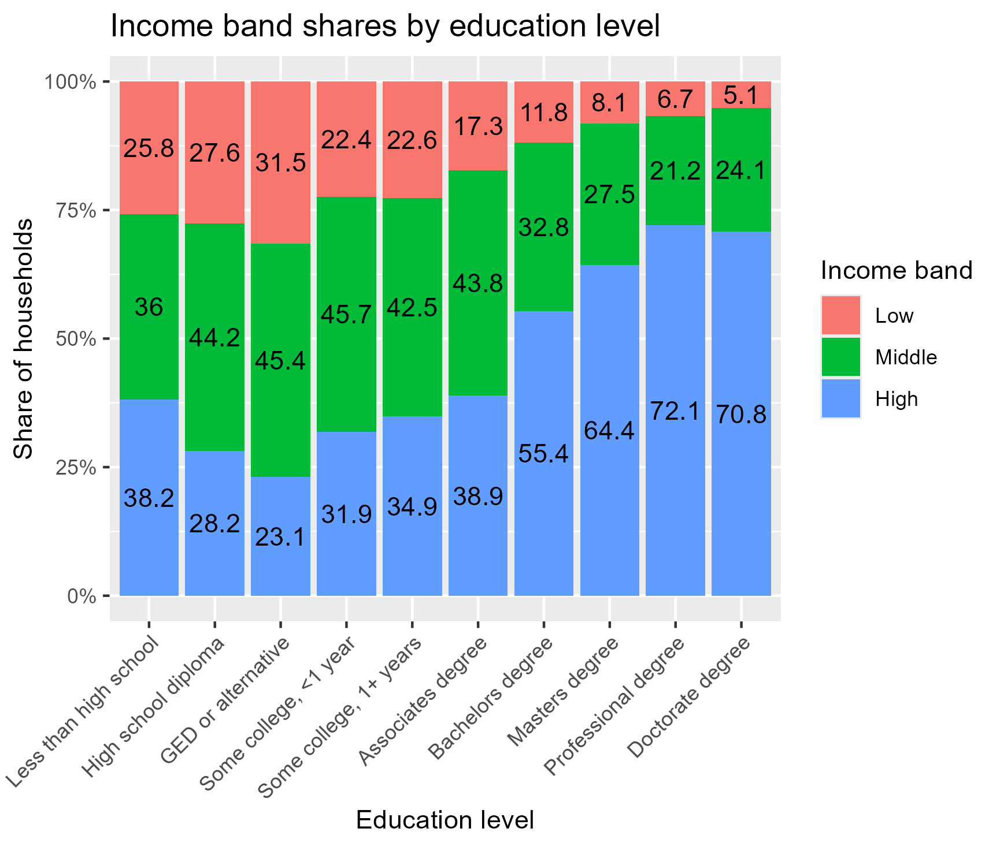
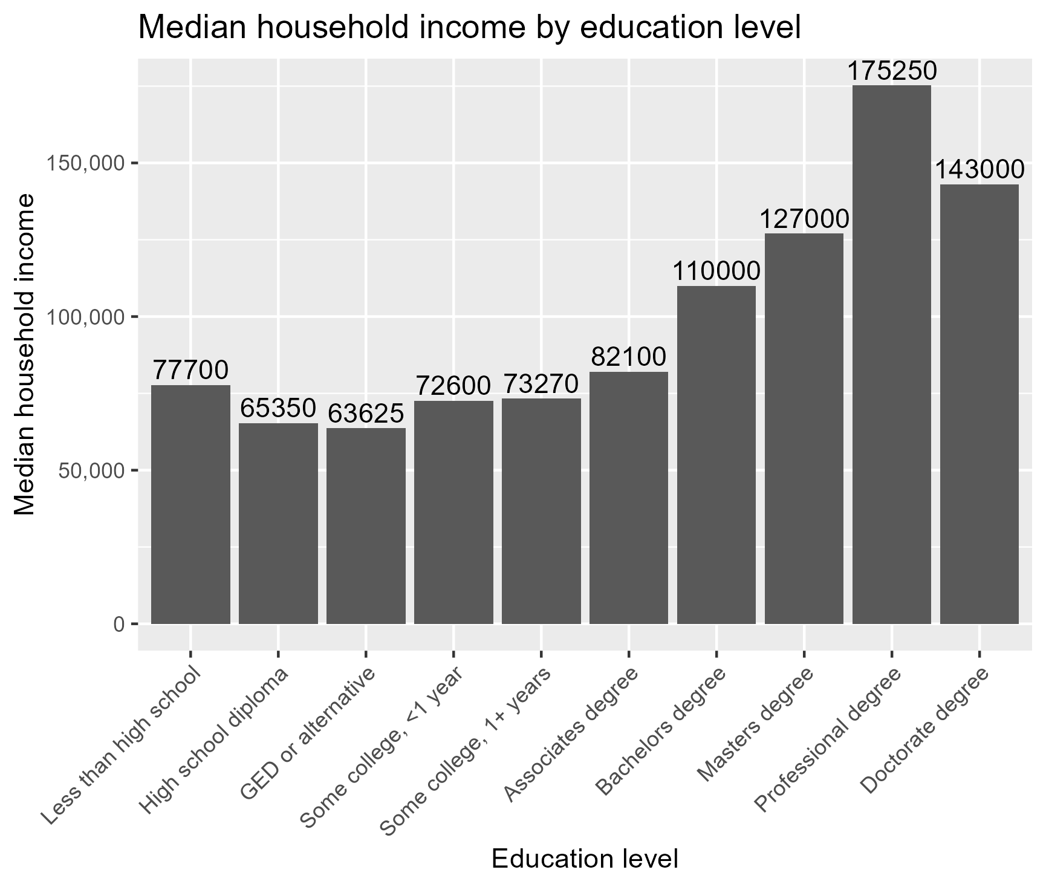
Visualizations – Education

Slide 28
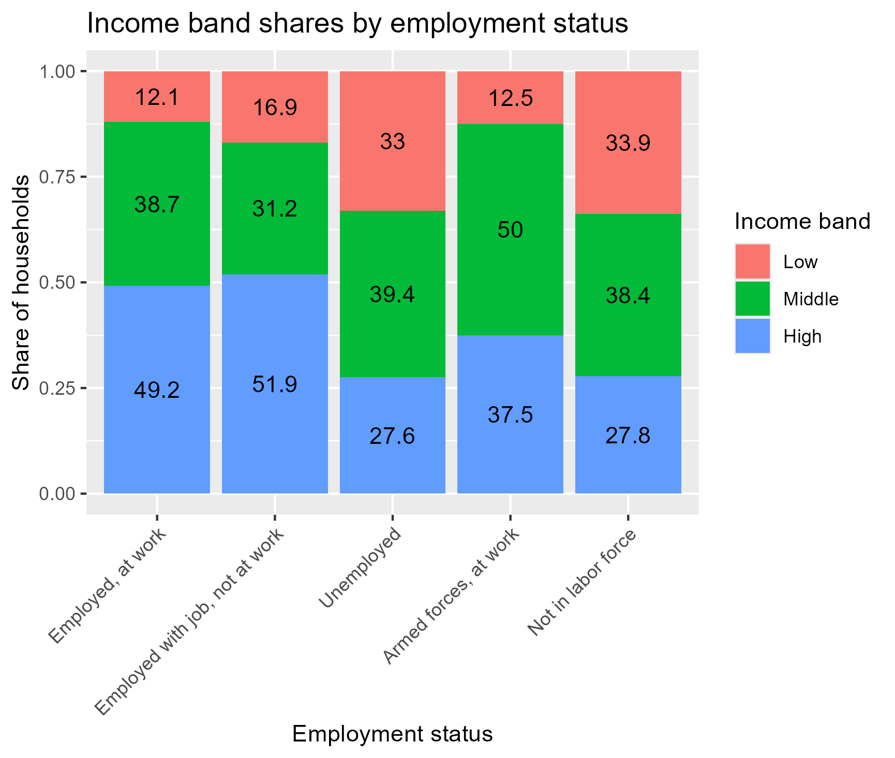
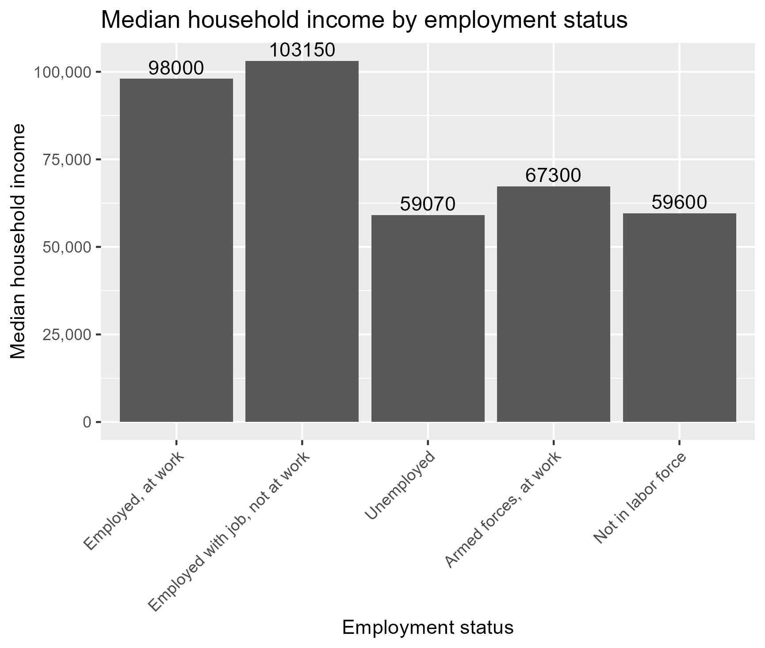
Visualizations – Employment

Slide 29
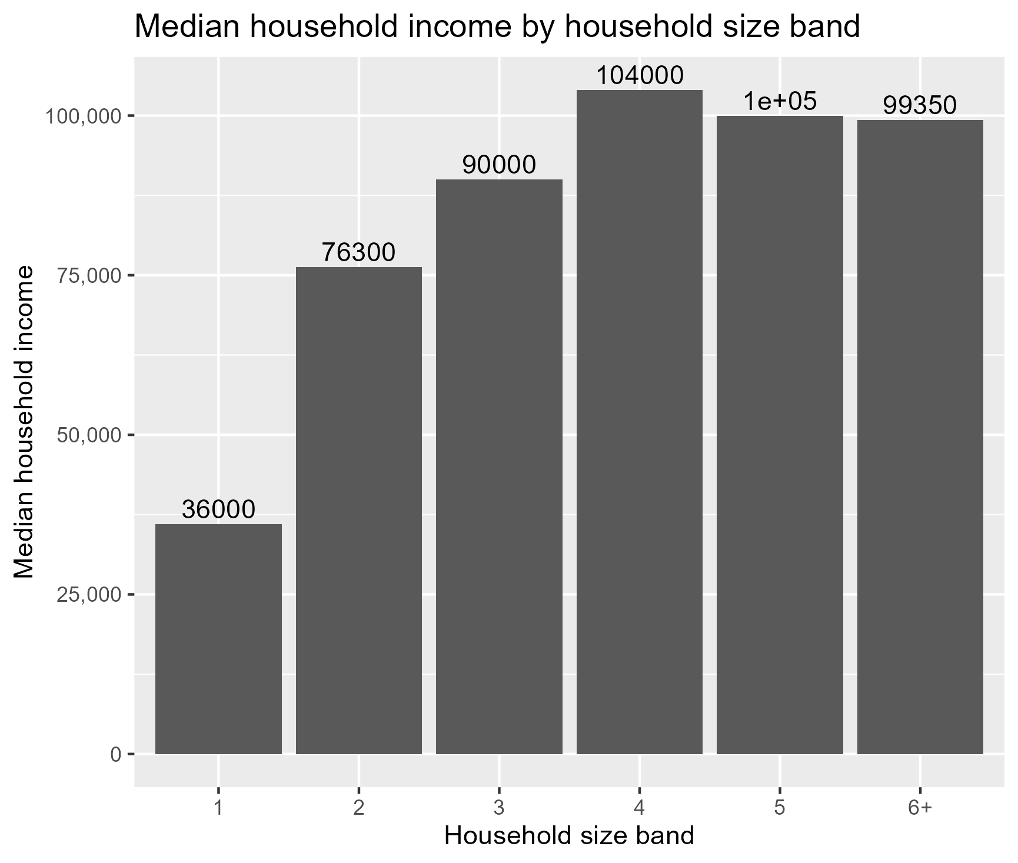
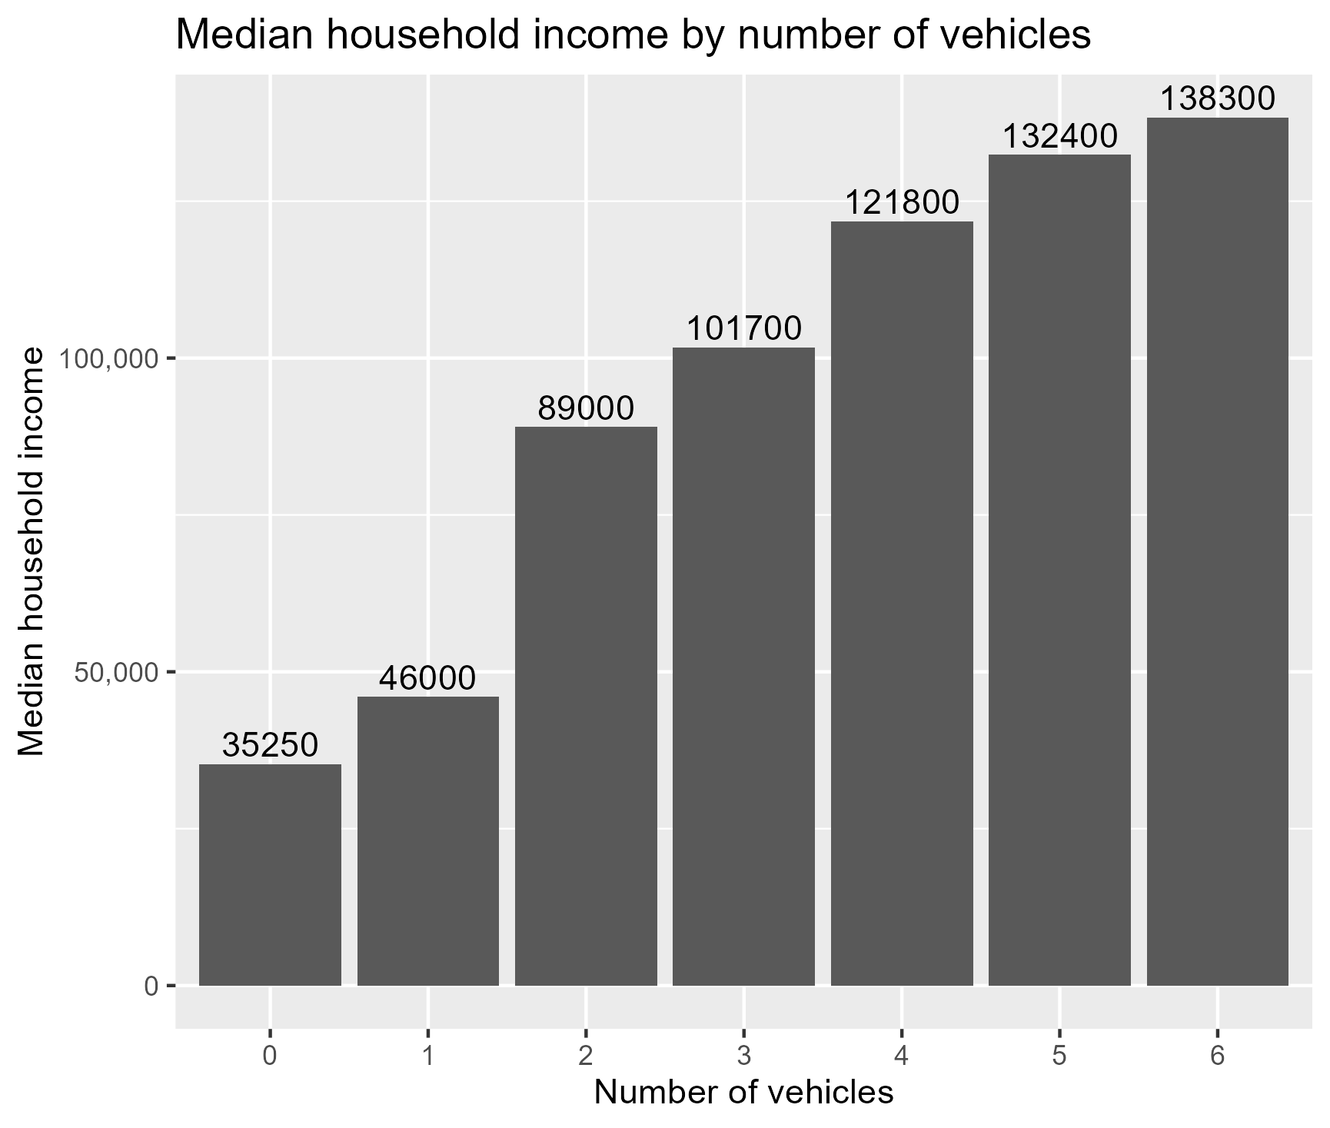
Visualizations – Misc

Slide 30
Key Findings
Drastic income gap – per the deciles and income gaps
The income bands for middle to high income-earners increase by education level
Median household income increases as the number of vehicles in the household increases

Slide 31
Project Limitations
Observational dataset – results are correlational, not causal
Other factors such as location not captured
Only a portion of data analyzed

Slide 32
Future Analysis
Stronger processing power to analyze full data
Greater multi-variable correlation emphasis
State and local level

Slide 33

Questions?

